Slide 1
﻿Adversarial Counterfactual Visual Explanations
CVPR’23

Slide 2
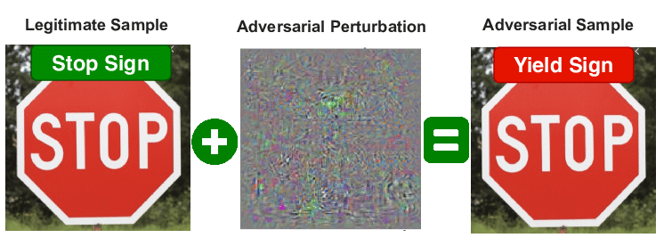
Adversarial Attack vs Counterfactual Explanations
Adversarial attack and CFEs both aim to flip the class by tweaking the model
Adversarial attacks are used to identify the limitation of a model whereas CFEs are used to explain why a model made a particular prediction
Real data + perturbation = adversarial sample
Perturbation is mostly noise and not actionable and not understandable for image data

Slide 3
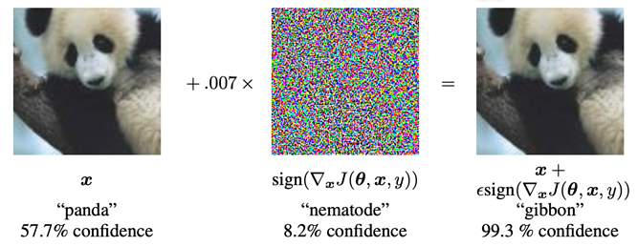
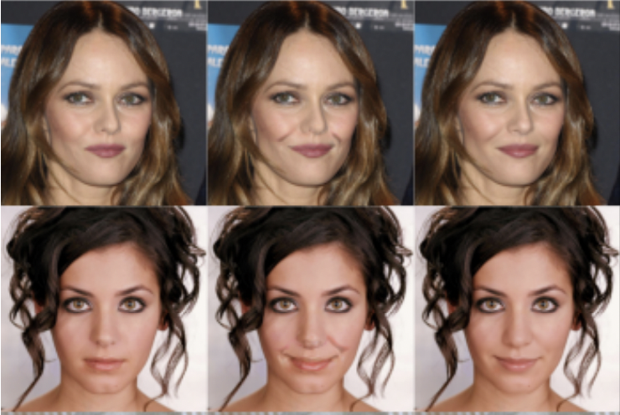
Adversarial Attack vs Counterfactual Explanations
Adversarial attack
CFE
CFE with post processing
original
CFE

Slide 4
Issues to solve
If you want to make a model robust, you have to change the model. That means training the model with adversarial samples.
The adversarial samples are unable to be used as CFEs
But one trait of adversarial attack is desired for CFE generation:
-- -- Adversarial samples are very close to the original sample

Slide 5
Objective
Come up with a method to robustify the model without retraining it, without changing it
Transform the adversarial attacks to CFEs

Slide 6
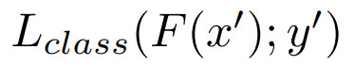
Method
2 step Filter technique
Pre-explanation generation:
Original input is (x, y)
The adversarial attack is x’ and target class is y’ (!=y)
Filtering mechanism is designed to enhance the robustness of the classifier by removing/reducing the impact of perturbations or noise in the input data.
Filter improve the classifier's ability to generalize to unseen or adversarially perturbed examples
Bringing the pre-explications closer to the input images:
Post-processing technique. Applies changes to make the perturbed images as close to unperturbed images as possible
minimize
Filter
Adversarial attack
Regular input → Use it to create CFE

Slide 7
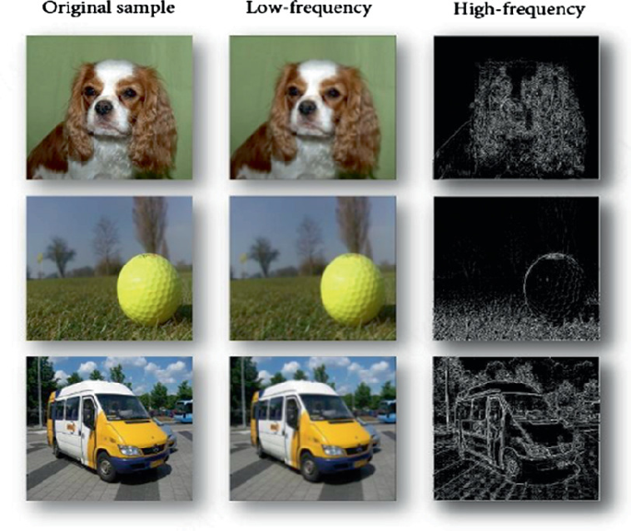
Pre-explanation generation
Filter design
Use ﻿Denoising Diffusion Probabilistic Models (DDPM) to suppress the impact of perturbations
﻿Removing high-frequency information: common traits of adversarial attacks
high-frequency perturbations could change the classifier’s decision without being actionable or understandable by a human.
﻿Producing in-distribution images without distorting the input image
﻿This property seeks to maintain the image structures not involved in the decision-making process as similar as possible
Phase 1
Phase 2
Use DDPM

Slide 8
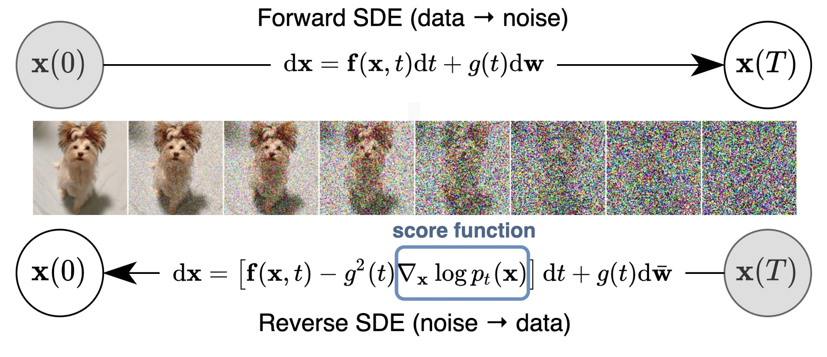
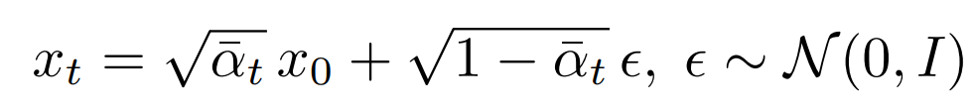
DDPM
t = 0
t = 1
t = 2
t = 3
t = 4
t = 5
……..
t = T
-
Multiple iterations →

Slide 9
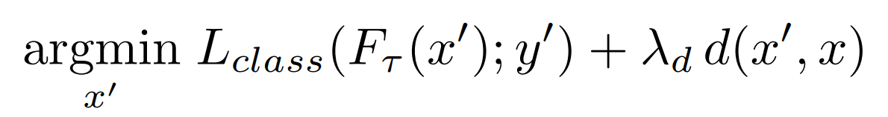
Pre-explanation generation
Filter design
Use DDPM

Slide 10
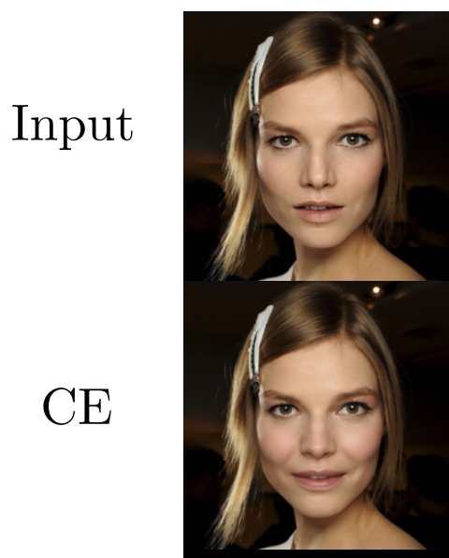
﻿Bringing pre-explanations closer to input images
Postprocessing phase
﻿The reconstruction will somehow preserve the overall structure of the image.
﻿A post-processing phase could help keep irrelevant parts of the image untouched
﻿Example: The reconstruction may change the hairstyle
while targeting the smile attribute. Since hairstyle is
presumably uncorrelated with the smile feature, the
post-process should neutralize those unnecessary
alterations

Slide 11
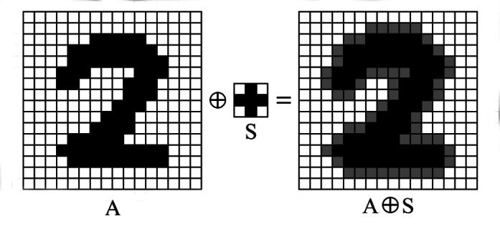
﻿Bringing pre-explanations closer to input images
Postprocessing phase
﻿Create a mask
Threshold(Dilate(reconstructed image – input image))
Merge the CFE’s ROI with the ROI of the mask
Merge the input with the uncorrelated part of the mask
Dilation: expanding the region

Slide 12
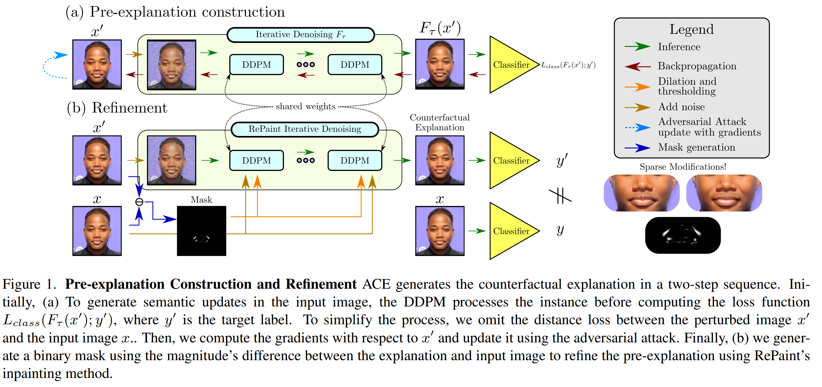
Complete Method

Slide 13
Evaluation Metrics
Flip Rate: ﻿Is the CE classified as the targeted label.
﻿Mean number of attributes changed (MNAC): Measures the smallest number of traits changed between the input-explanation pair (﻿Sparsity)
Face Verification Accuracy (FVA): Does the CFE change the person?
﻿Face Similarity (FS): ﻿cosine distance between the encoding of image-counterfactual pairs
﻿COUT measures the transition probabilities between the input and the counterfactual
FID ﻿measures Realism of counterfactual images
sFID contains multiple iterations of FID to remove any bias

Slide 14
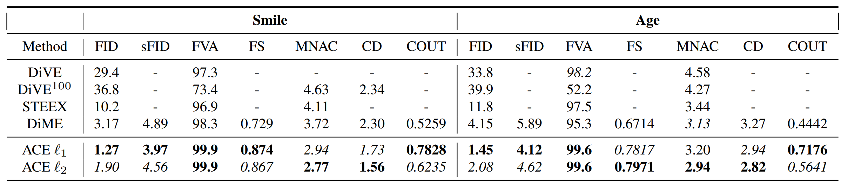
Results

Slide 15
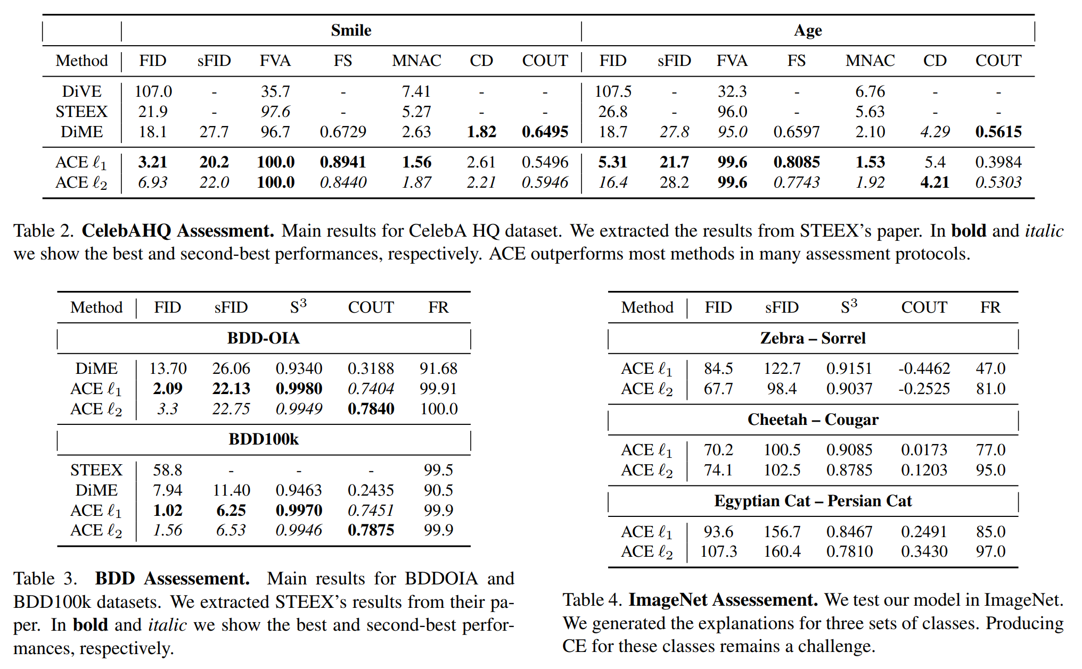
Results

Slide 16
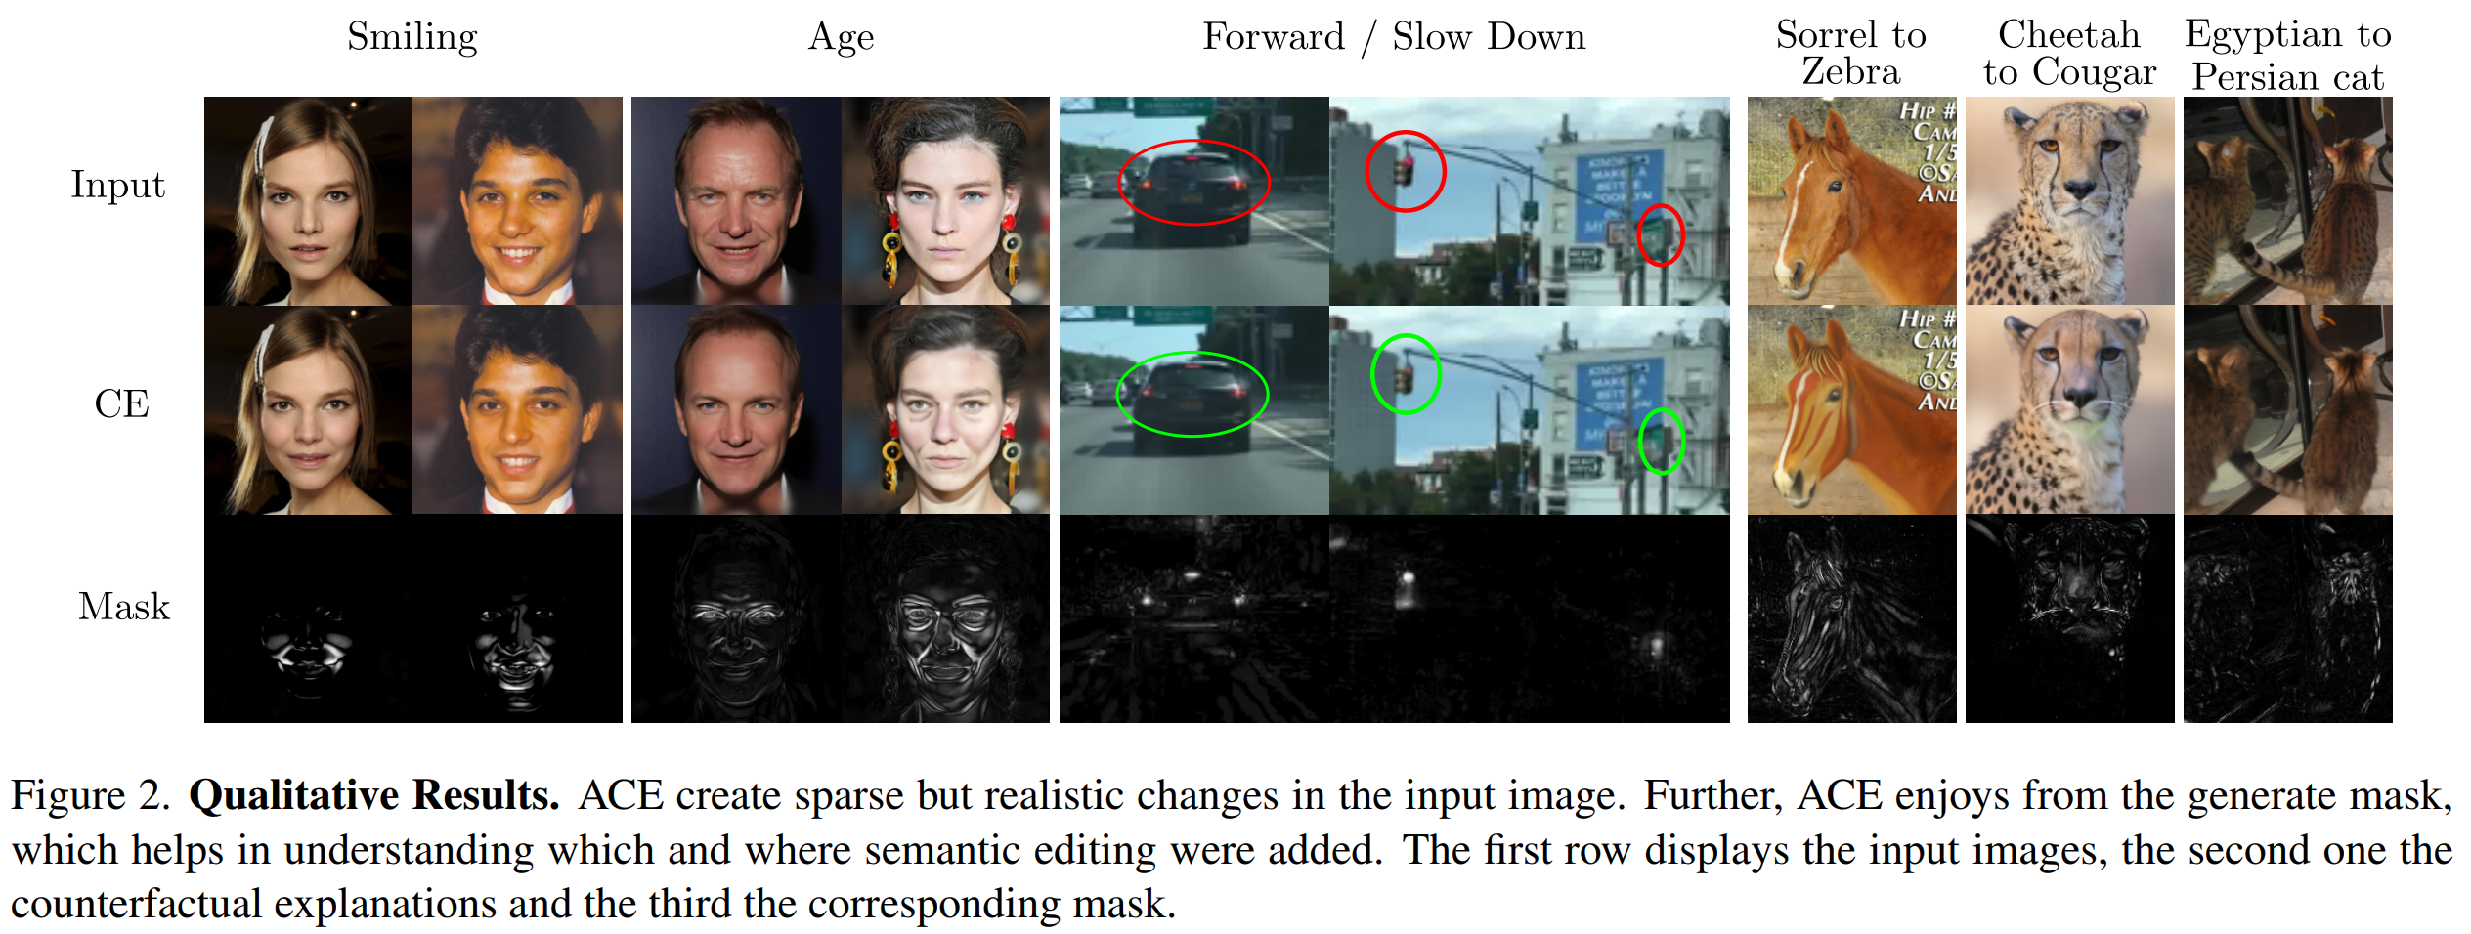
Results

Slide 17
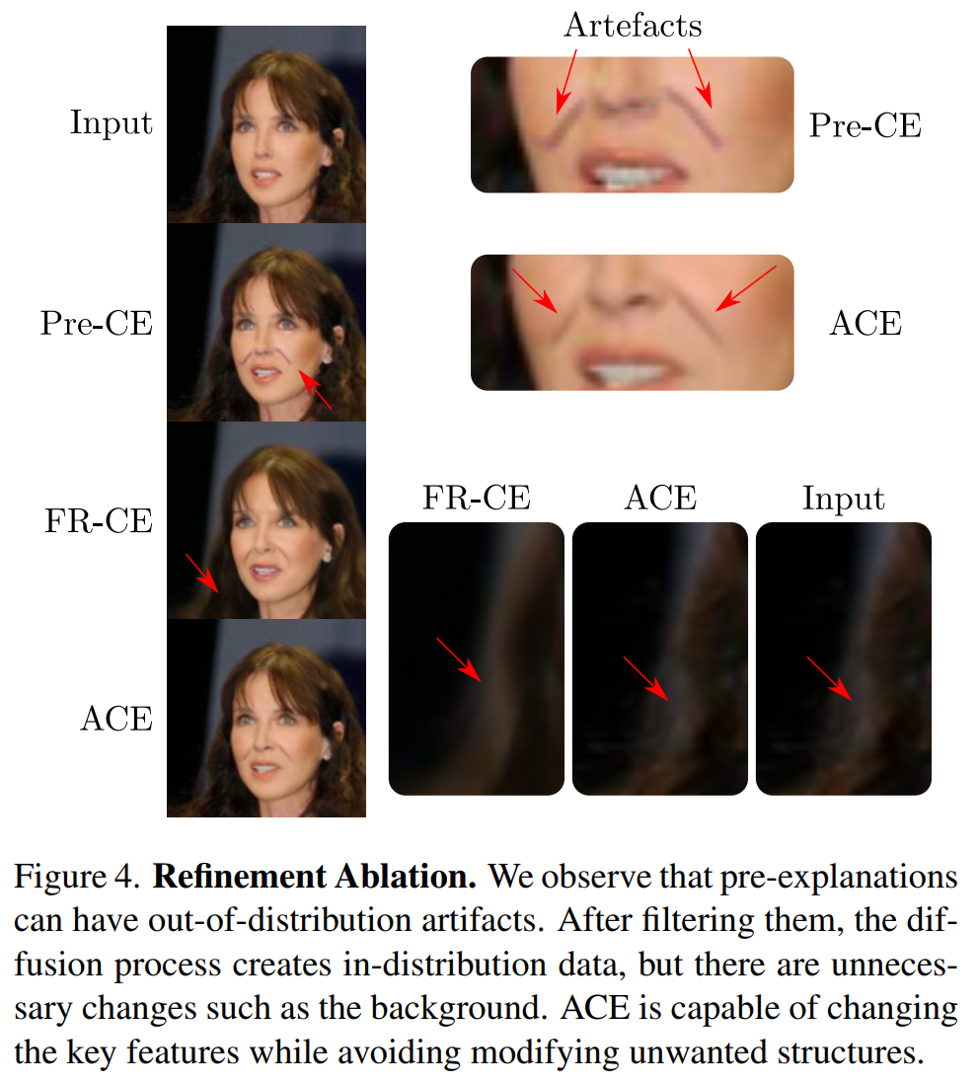
Results

Slide 18
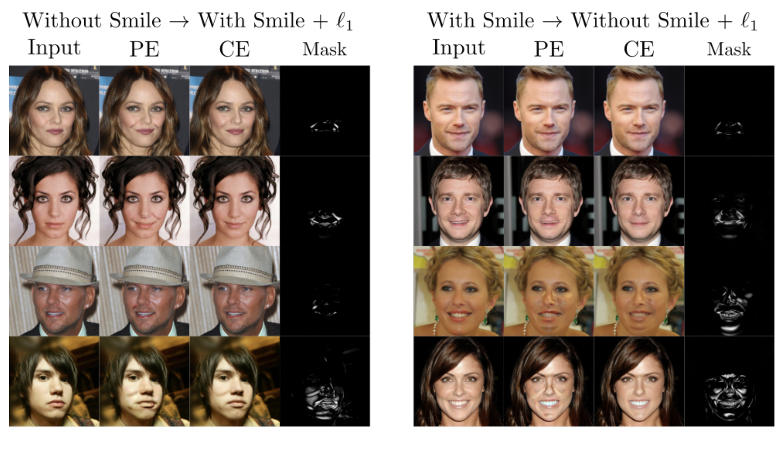

Results

Slide 19
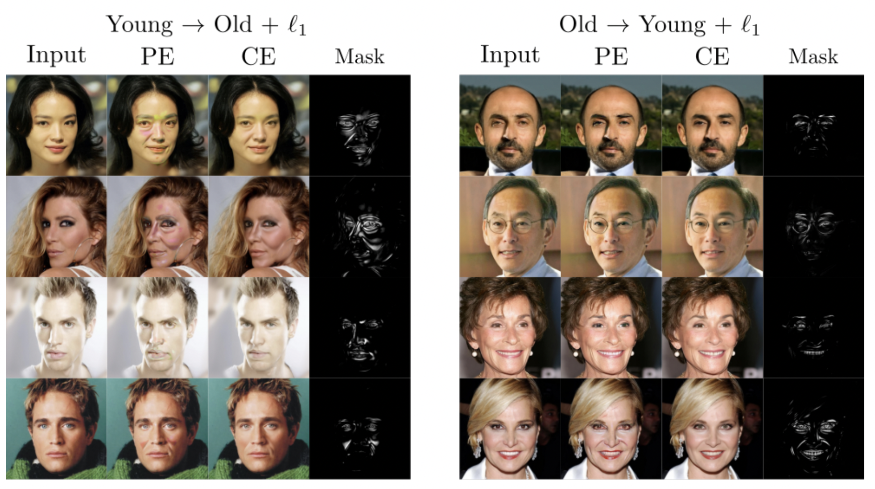
Results

Slide 20



Diffusion model as an image generator
t = 0
t = 1
t = 2
t = 3
t = 4
t = 5
……..
t = T
With embedding
Amplify the difference and keep adding it to the generated image
embedding
Cat on a hat
Without embedding

